Slide 1
The Effect of Accounting versus Economic Determinants on the use of Broad-based Option Plans
Hemang Desai
Zining Li
Suning Zhang
CAPANA Conference Discussion
Mark T. Bardshaw
July 1, 2010

Slide 2

Witty Intro: Non-Acknowledgements
Feti Travel
65 Harrison Ave. Suite 402
Boston, MA 02111
Quality Control Failure #1: “Bardshaw”
Quality Control Failure #2: Missing CTU-PEK leg
Notes:
It is customary to begin presentations by thanking various people who have helped you along the way. This presentation begins somewhat differently, as I’d like to NOT thank the travel agent from Boston’s Chinatown who acted as an agent for those who wish to keep me out of China.
Seriously, it was my great pleasure to be asked by Zhaoyang to discuss the paper by Desai, Li and Zhang, in light of my last minute cancellation to discuss a paper at the 2009 conference due to a death in the family.

Slide 3
What, Why, How?
What do they do?
  We all know option compensation increased dramatically in the 1990s, then declined
  Q: What is the explanation for the temporal change in option intensity?
    Financial reporting loophole? Economy? Labor markets? Risk optimization?
    Cash management? Rent extraction? Greed? Herding? Ignorance?
Why important?
  1st, options grants are huge;
  1993 ‘Rally in the Vally’
  2nd, Very mixed literature
How do they implement the study?
  Construct proxies for covariates; Cross-sectional Tobit analyses of employee option grants with covariates; Pre/Post SFAS123R; Changes specification; other analyses
Notes:
Nice importance, as it speaks to a debate in both the academic literature AND the ‘real world’
Bernard Marcus, CEO of Home Depot responded, “You’re trying to confuse me with logic here. Mr. Marcus went on to assert that if Home
Depot had been forced to expense its stock options grants since the time it went public in 1981, his company would be ten percent of its current size.

Slide 4
Priors
Obviously, financial reporting costs/benefits explain option use
Plus, existing evidence on
  Repricing ‘abuse’ around 12/15/1998 variable method treatment of repricing (Carter et al. 2003)
  Vesting ‘abuse’ around effective date of SFAS 123R (Choudhary et al. 2009)
 | Cash? | Stock? | Options?
Attract | Y | Y | Y
Motivate | Y | Y | Y
Retain | Y | Y | Y
Conserve cash | N | Y | Y
Expense = Ø | N | N | Y
Notes:
I think what is going on is the prior research started with my same priors, and focused the research on confirming these priors. In doing so, they may have spent less time attempting to control for economic determinants of option grants. What the authors do, in my opinion, is to focus on economic determinants to confirm that they matter. The presentation ends up being a big lopsided because of the interpretation of the sign or insignificance of the financial reporting cost variables. However, the message is a good one.
Plus literature on purchase vs. pooling (CEO/CFO abandonment of deals b/c couldn’t get pooling treatment), smoothing literature, etc.
Thus, the authors are questioning the voracity of the accounting explanation after a heap of evidence showing that in all kinds of contexts, especially stock options, managers are very concerned about the financial reporting impact of various operating/investing/financing activities.

Slide 5
Contribution
Classic academic battle
  Core/Guay/Larcker et al.: “Executive Equity Compensation and Incentives”
  Hall/Murphy et al.: “The Trouble with Stock Options”
    Backdrop is the old “accounting matters vs. not” debate
  An additional, alternative view
    People (and hence firms) are crazy
      i.e., they didn’t (or don’t) understand the value of options;
      ⇒ Out of equilibrium activity observed
Oversimplificaiton of
  Prior research: ≈ Accounting explains 100% of option use
  Desai, Li & Zhang: ≈ Economic factors explain 100% of option use
  Truth: ≈ A combination of accounting and economic factors
  explain option use … this is the contribution
A great contribution would be to provide an approximation
  i.e., 50/50, 80/20, etc.
Notes:
“False and not nice”
On one level, this is an academic jousting match with limited importance. For example, some chide efficient market adherents who believe the internet bubble was not a bubble … one day prices reflected info, and so did they the next day. Here, did option use increase because of the accounting loophole, or because of hot economic activity during the 90s/00s, or a combination? Answer is probably both, but this doesn’t prevent academics with too much time on their hand from making extreme statements.
Authors seem to be biased towards efficiency. Even say, they “examine relation between employee option grants and financial reporting costs/benefits while controlling for the economic and labor market determinants of employee option grants.” Really, it is symmetric.

Slide 6
First, a Pet Peeve
Option grants have always had to be expensed
  APB 25, SFAS 123, SFAS 123R
    The variation across standards pertains primarily to measurement
      APB 25: Intrinsic value
      SFAS 123: Intrinsic value or fair value
      SFAS 123R: Fair value

Slide 7
Results
Table 3
  B.S. Option Value = f(Financial reporting factors, Economics/Labor, other)
  Pre- and post-SFAS 123R
Table 4
  Same thing, in changes
Table 5
  Similar to Table 3, but for CEOs
Table 6
  Similar to Table 3, but LHS is restricted stock
Table 7
  Early adopters of SFAS 123R
Table 8
  Almost same as Table 4
Notes:
T1 and T2 are the standard descriptives & correlations

Slide 8
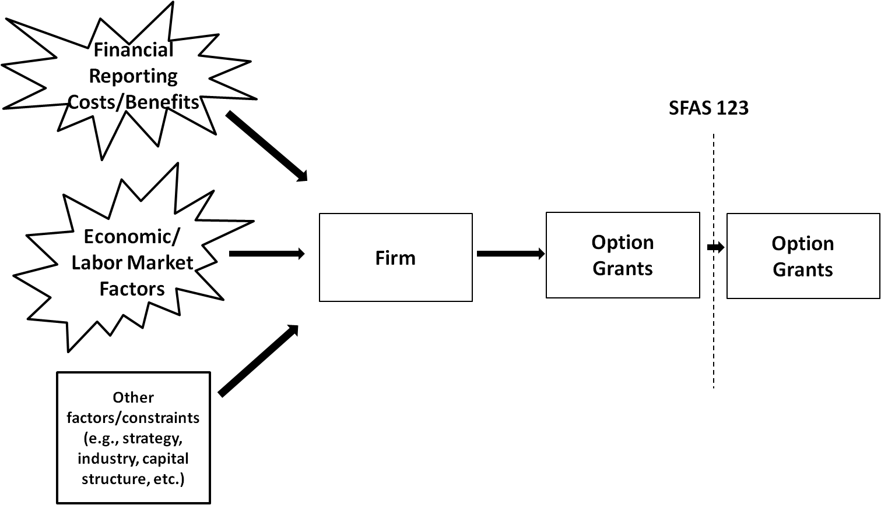
Picture
Temporal variation
Endogeneity of regulation
Construct Validity
Construct Validity
Construct Validity
Correlated Omitted Variables
(Base cash compensation;
other equity compensation;
other perquisites/benefits;
governance; etc.)
Notes:
Note the back and forth between firms and FASB re: delay of SFAS123R. From 2004 to late 2005.

Slide 9
In an Ideal World
What is the benchmark?
  Ideal study
    Random assignment of pairs of identical firms to intrinsic value (0 expense) vs. fair value (>0 expense) groups
    Then observe option grants across years
Workaround used by authors
  Armada of control variables
  Changes analysis
  Specification/robustness tests

Slide 10
Things I Like
Jumping into a battle zone
Authors here use all grants*
Prior studies on basically same question use only CEO or Top 5;
  Authors nicely emphasize 90% of option grants go to other than Top 5
Addressing a possible correlated omitted variables problem in prior research (i.e., economic/labor market factors)
Discussion on p. 11 (re: possible misspecification of prior accounting-cost focused research)

Slide 11
Things I Worry About:
#1 A lot rests on the validity of FINRPT1 and FINRPT2
Many different terms used for a vague concept
  “Financial reporting costs”
  “Financial reporting benefits”
  “Accounting considerations”
  “Accounting benefits”
  “Higher reporting concerns”
  Gracefully failing to reject the null of no relation
  Conclusions rest on insignificance of coefficients on “financial reporting costs” in changes (or on significance … see #3 in two slides)
  Although I like the changes analysis (a lot), how much would ‘financial reporting costs’ really change on average?

Slide 12
Things I Worry About:
#2 Benchmark
The use of total value of option compensation is understandable
  But, it is not without significant limitations
  Unlike the research on Top 5 executives, difficult to control for other comp. at the rank-and-file level … they’re different
Authors predict that firms with more “accounting considerations” will issue more options “because of the larger accounting benefits”
  Why then, for example, did they not issue even more options and pay less in cash and other forms?
Not sure if a benchmark option compensation is specified by research design
  Cross-sectional
    This captures ‘more’ option compensation or not, relative to the cross-section, holding other explanatory variables fixed
    This is different than ‘Excessive’ or not
      Which is the basis of the motivation
    More importantly, exclusion of presumably highly variable other compensation
      Salary, bonus, vacation time, work-from-home, firm identity, perks, products & markets, etc.

Slide 13

Things I Worry About:
#3 Basis for conclusions
P. 27 (re: significance of FINRPT1 post-SFAS 123R)
  “… However, a positive and significant coefficient on FINRPT1 is not consistent with an accounting based explanation. A positive and significant coefficient suggests that firms with greater financial reporting concerns grant more options over the 2005-2007 period, which is inconsistent with a financial reporting costs argument, as these options have to be expensed and hence there should be no association between financial reporting costs and option grants.”

Slide 14
Things I Worry About:
#3 Basis for conclusion (cont.)
P. 29-30 (re: changes specification)
  “This approach allows each firm to act as its own control, thereby minimizing the concern that our findings are driven by some omitted firm-specific variables. This advantage however, comes at the cost of low power, as this approach eliminates the cross-sectional variation in the level of option grants that is related to the various firm characteristics.”
    Perhaps more importantly, do we expect significant year-to-year variation in firms’ financial reporting benefits/costs?

Slide 15
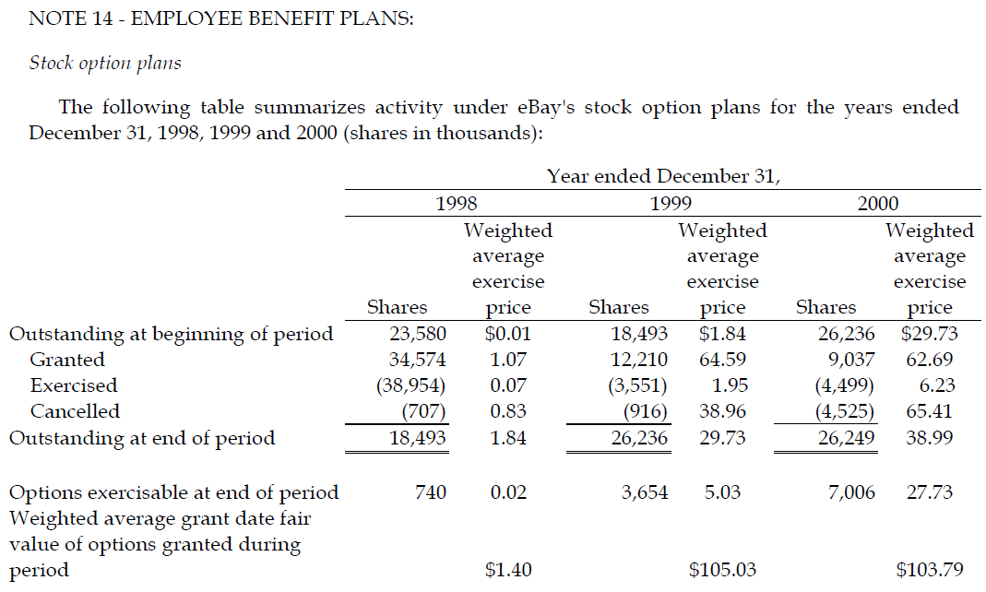
Things I Worry About
#4 Recognition vs. disclosure effects

Slide 16
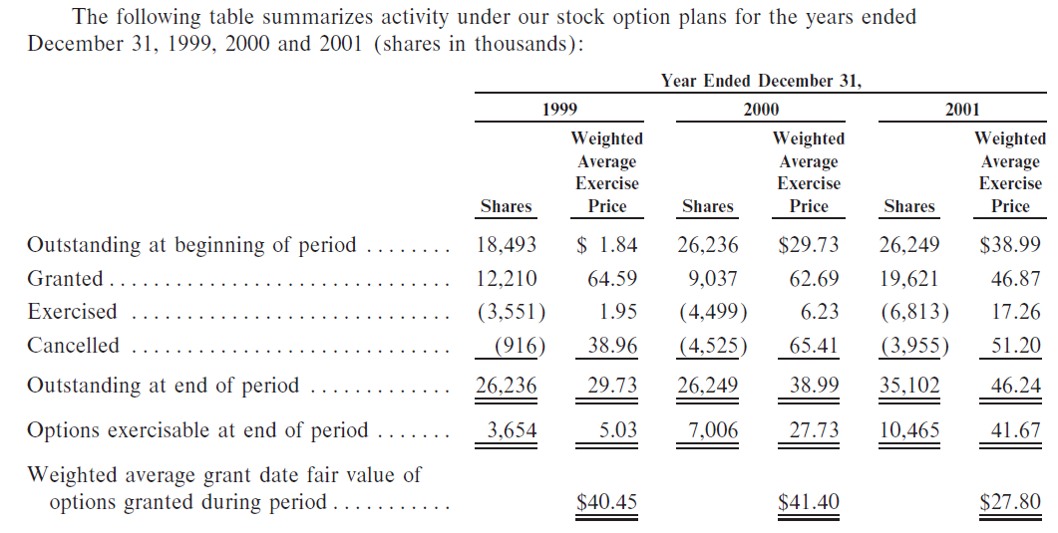
FYI, eBay fixed the problem in 2001
Previously: $105.03 $103.79

Slide 17
Takeaway
Very interesting literature
  Studying how much other people make
Nice point made that highlights how the ‘accounting’ explanation ought to map better to total options (not just Top5)
To the extent proxies capture elements of financial reporting costs, these seem second order to economic factors in explaining option compensation
Given the battle lines in this literature, the referee draw will be important!

